Slide 1
ESP-32 Tutorial Setup:
Internal Project Competition
By Matias Guillen

Slide 2
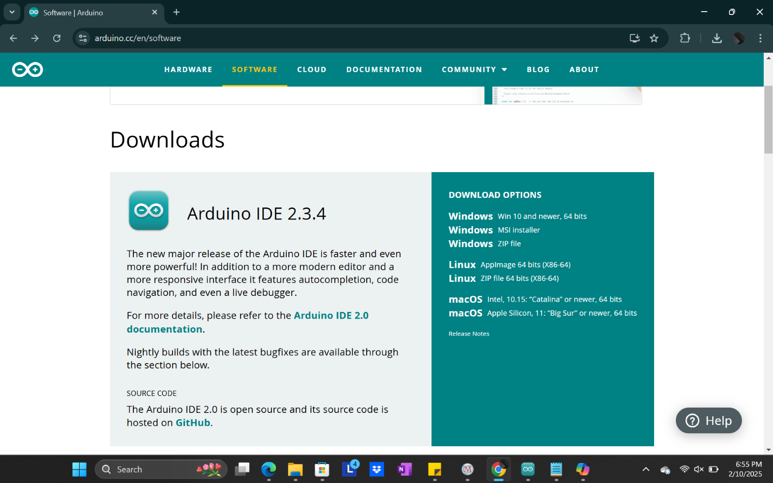
Go to arduinos website: https://www.arduino.cc/

Slide 3
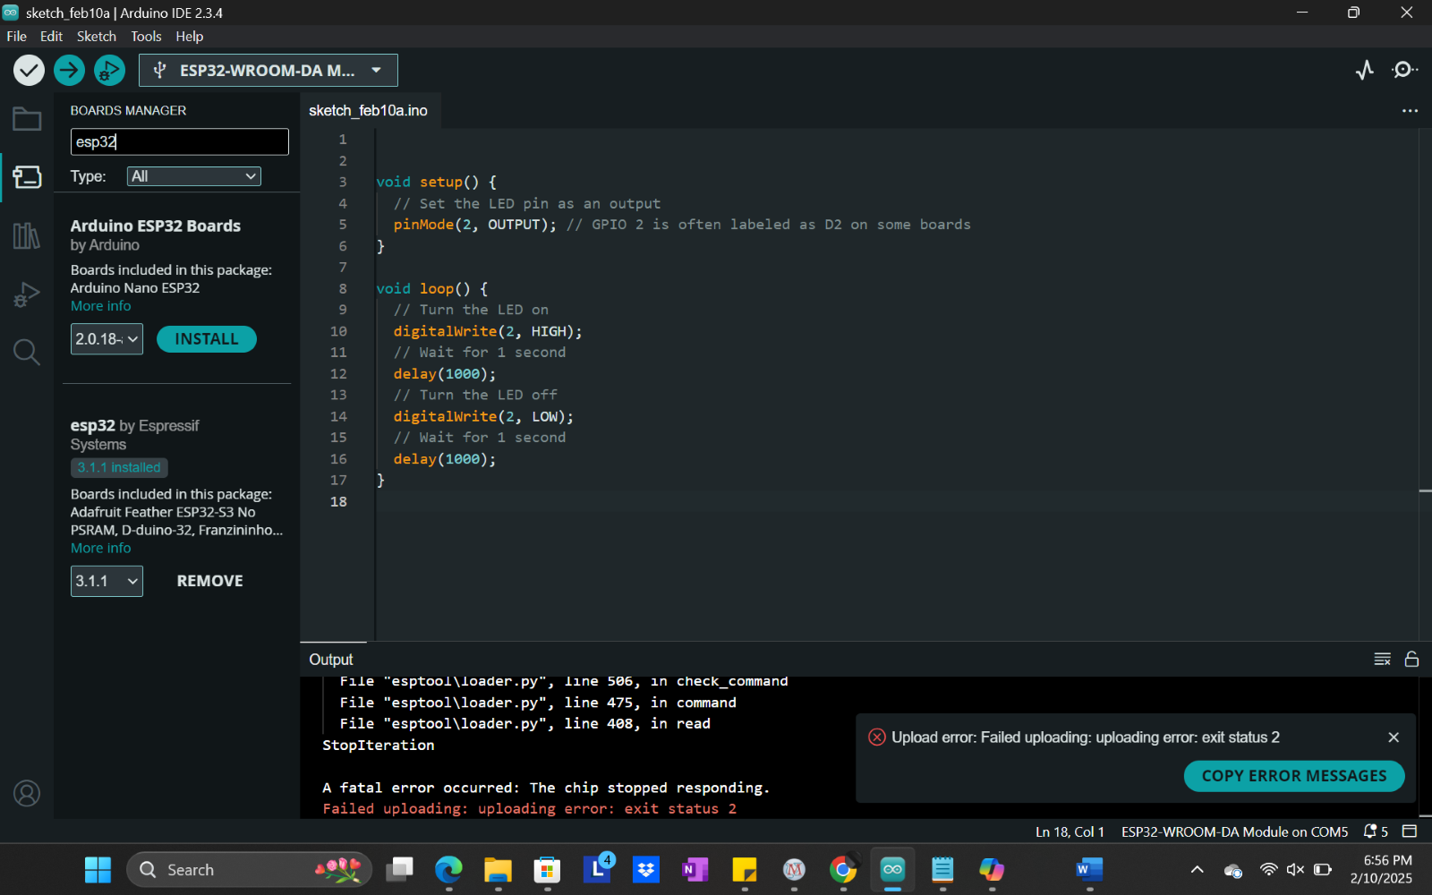
Once download go to “Boards manager” and search ESP32

Slide 4
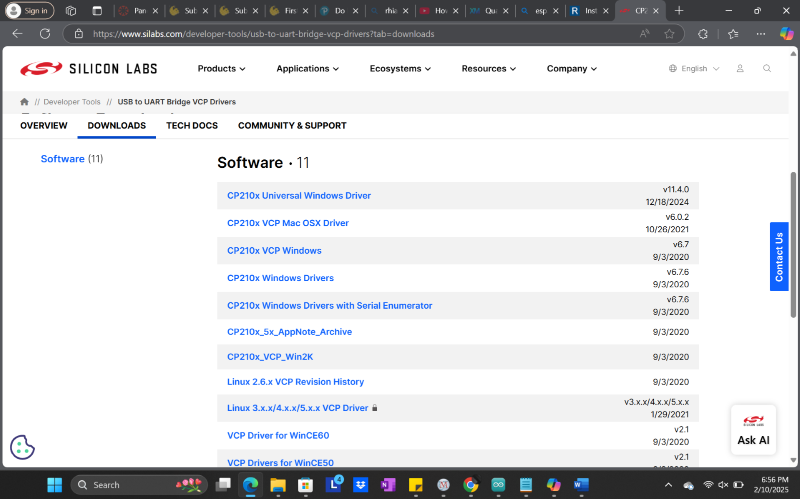
Once download install the drivers for the ESP32: https://www.silabs.com/developer-tools/usb-to-uart-bridge-vcp-drivers?tab=downloads

Slide 5
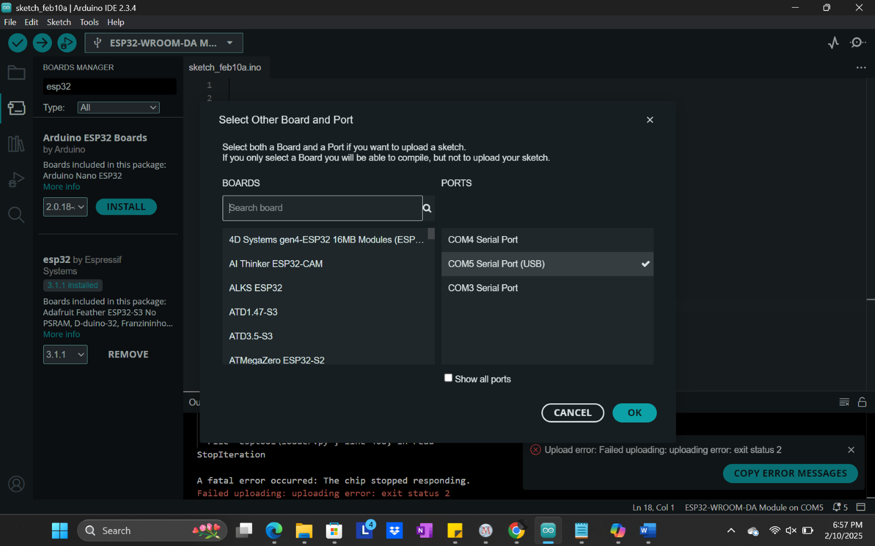
Now that everything is installed proceed to open up the menu and unplug and plug your USB cord (usb to microusb). Ensure that you select the correct COM port that is registered.

Slide 6
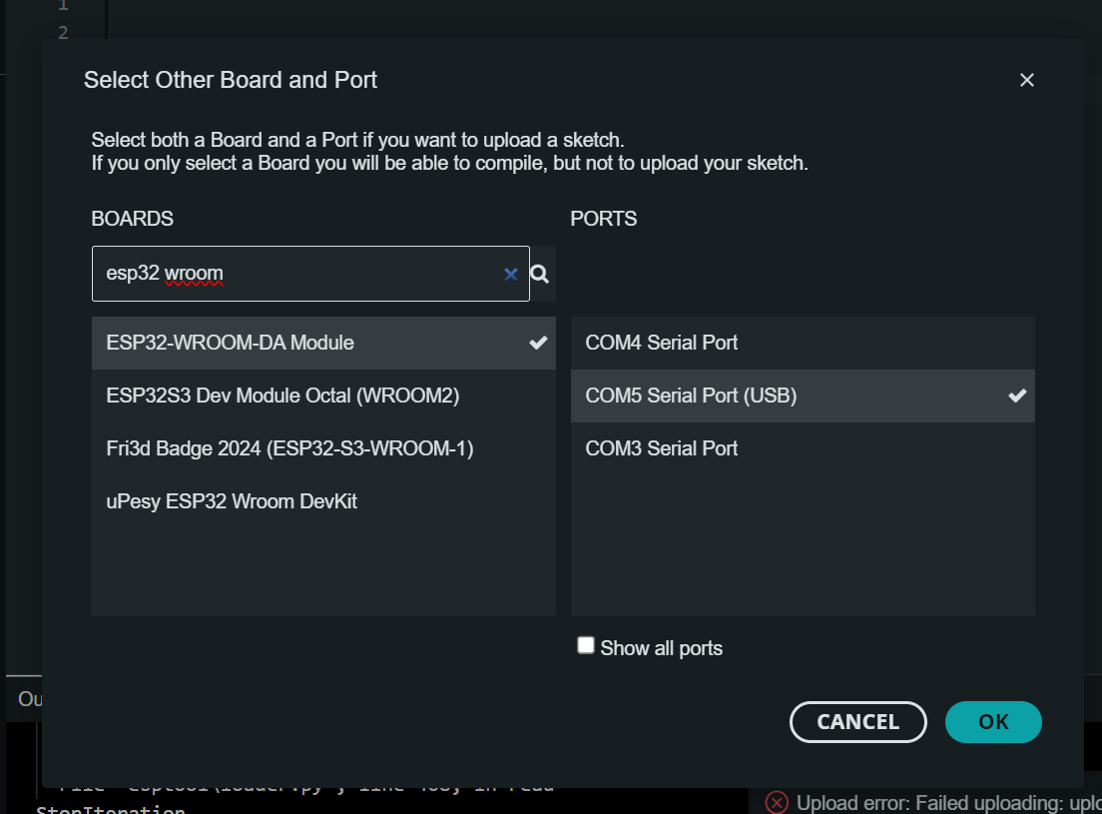
Search in the boards search bar
“Esp32 vroom”. Select the module pointed at.

Slide 7
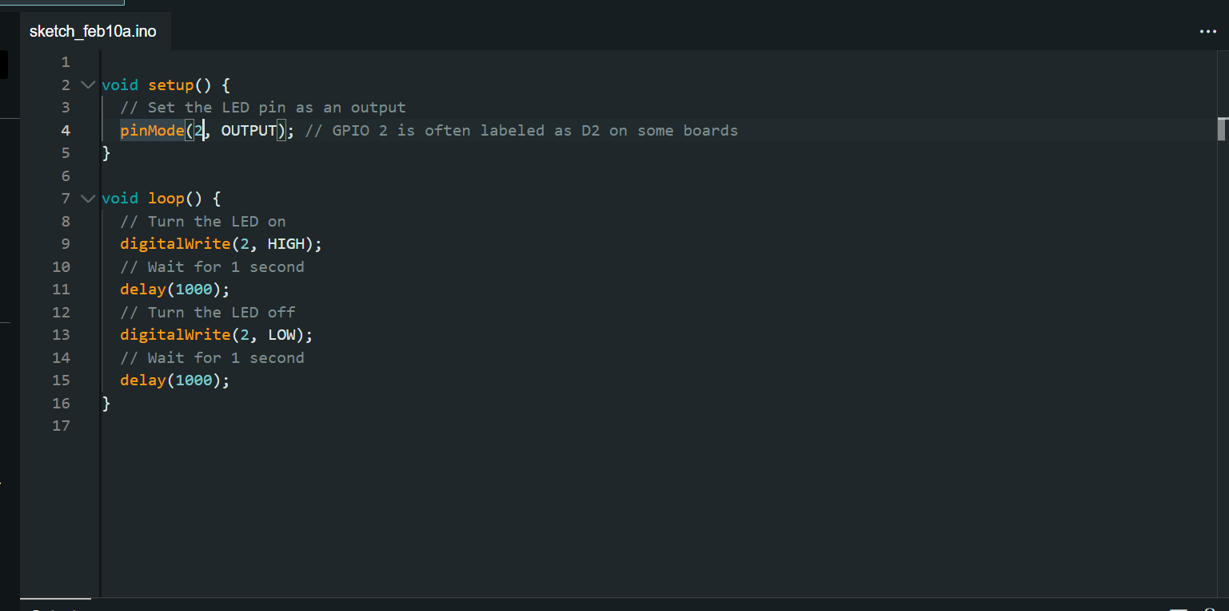
Program your ESP-32! Above is a template that can turn on and off the LED. However your board doesn’t have this pin. Next slide will show a diagram. Please watch any other videos if you are confused about how to program or setup.

Slide 8
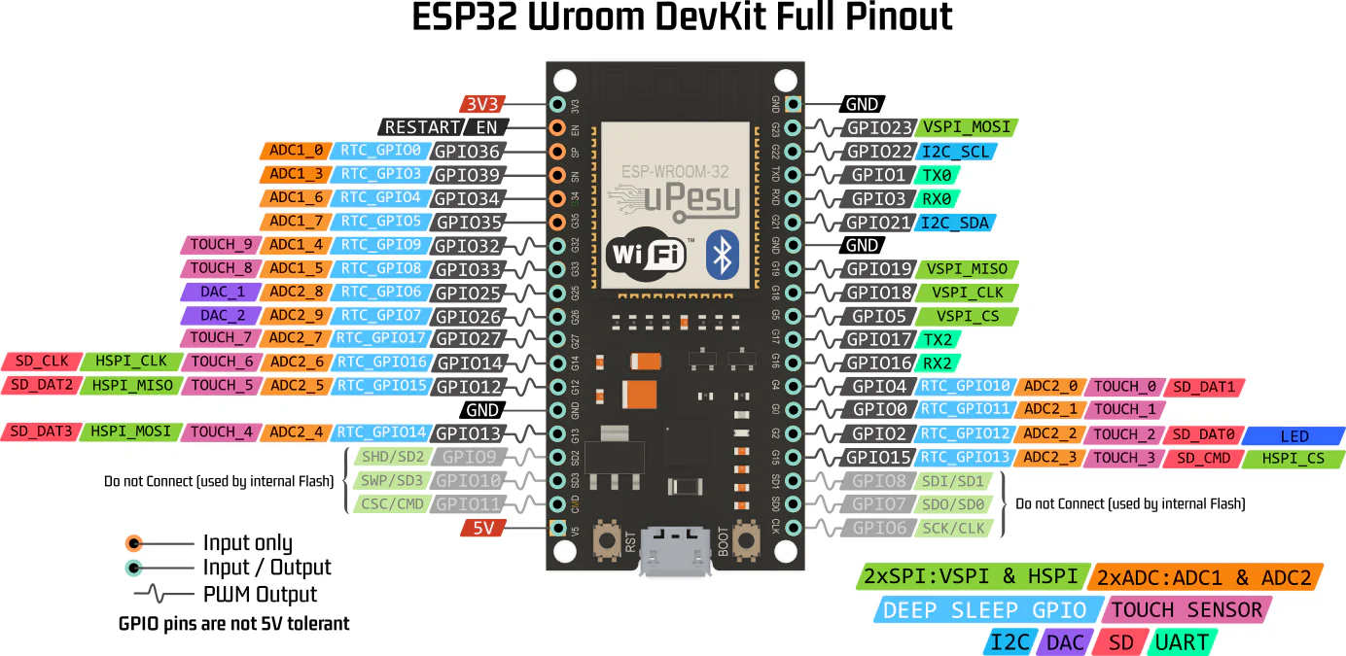
Pinouts

